Slide 1
Copyright Notice
These slides are distributed under the Creative Commons License.
DeepLearning.AI makes these slides available for educational purposes. You may not use or distribute these slides for commercial purposes. You may make copies of these slides and use or distribute them for educational purposes as long as you cite DeepLearning.AI as the source of the slides.
For the rest of the details of the license, see https://creativecommons.org/licenses/by-sa/2.0/legalcode

Slide 2
Overview
deeplearning.ai

Slide 3


Learning objectives

Slide 4
Learning objectives
What is autocorrect?

Slide 5
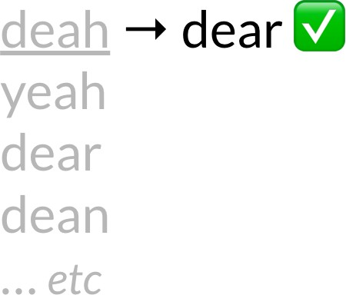
Learning objectives
What is autocorrect?
Building the model

Slide 6
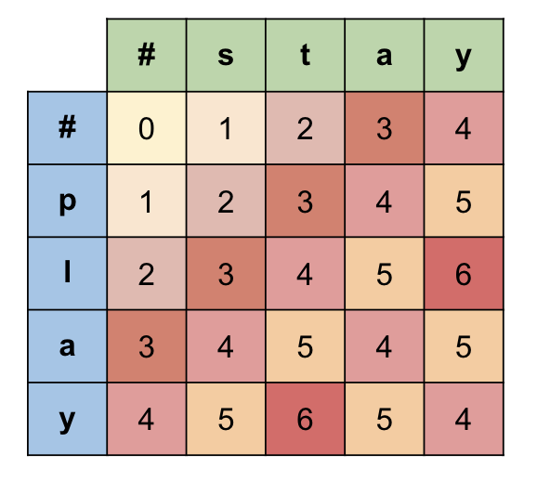
Learning objectives
What is autocorrect?
Building the model
Minimum edit distance

Slide 7
Learning objectives
What is autocorrect?
Building the model
Minimum edit distance
Minimum edit distance algorithm

Slide 8
Autocorrect
deeplearning.ai

Slide 9

What is autocorrect?

Slide 10
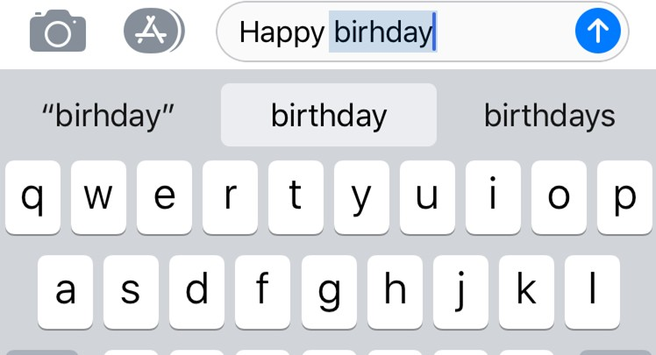
What is autocorrect?
Phones

Slide 11
What is autocorrect?
Phones
Tablets

Slide 12
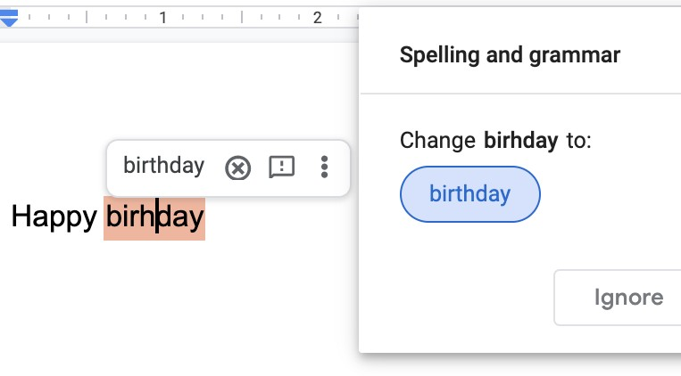
What is autocorrect?
Phones
Tablets
Computers

Slide 13
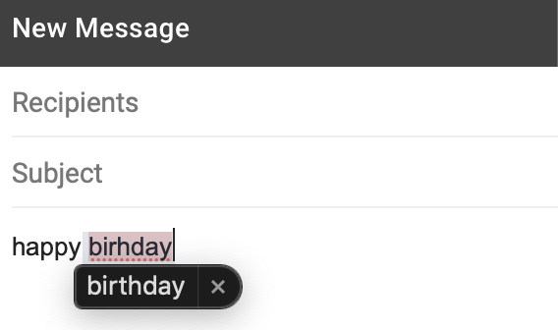
What is autocorrect?
Phones
Tablets
Computers

Slide 14
What is autocorrect?
Example:
Happy birthday deah friend! 🎂

Slide 15
What is autocorrect ?
Example:
✅
🎂
Happy birthday
dear
friend!

Slide 16
What is autocorrect?
Example:
🦌 ??
Happy birthday deer friend!

Slide 17
How it works
Identify a misspelled word
Find strings n edit distance away
Filter candidates
Calculate word probabilities

Slide 18
How it works
deah
1. Identify a misspelled word
Find strings n edit distance away
Filter candidates
Calculate word probabilities

Slide 19
How it works
deah
_eah d_ar de_r
… etc
1. Identify a misspelled word
2. Find strings n edit distance away
Filter candidates
Calculate word probabilities

Slide 20
How it works
deah yeah dear dean
… etc
Identify a misspelled word
Find strings n edit distance away
3. Filter candidates
4. Calculate word probabilities

Slide 21
How it works
deah yeah
Identify a misspelled word
Find strings n edit distance away
Filter candidates
dear
4. Calculate word probabilities
dean
… etc

Slide 22
How it works
deah → dear ✅
yeah
Identify a misspelled word
Find strings n edit distance away
Filter candidates
Calculate word probabilities
dear
dean
… etc

Slide 23
Building the model
deeplearning.ai

Slide 24
Building the model
Identify a misspelled word
Find strings n edit distance away
Filter candidates
Calculate word probabilities

Slide 25
Building the model
1. Identify a misspelled word
Find strings n edit distance away
Filter candidates
Calculate word probabilities

Slide 26
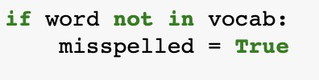
Building the model
1. Identify a misspelled word
deah ?? 🤔

Slide 27
Building the model
1. Identify a misspelled word
deah
❌

Slide 28
❌
Building the model
1. Identify a misspelled word
deah
🦌 ✅
deer

Slide 29
❌
Building the model
1. Identify a misspelled word
deah
🦌 ✅
🎂
Happy birthday deer !

Slide 30
Building the model
1. Identify a misspelled word
2. Find strings n edit distance away
Filter candidates
Calculate word probabilities

Slide 31
Building the model
2.
Find strings n edit distance away

Slide 32
Building the model
2.
Find strings n edit distance away
Edit: an operation performed on a string to change it

Slide 33
Building the model
2.
Find strings n edit distance away
Edit: an operation performed on a string to change it
Insert (add a letter)

Slide 34
Building the model
2.
Find strings n edit distance away
Edit: an operation performed on a string to change it
Insert (add a letter)
‘to’: ‘top’, ‘two’ …

Slide 35
Building the model
2.
Find strings n edit distance away
Edit: an operation performed on a string to change it
Insert (add a letter)
‘to’: ‘top’, ‘two’ …
Delete (remove a letter)

Slide 36
Building the model
2.
Find strings n edit distance away
Edit: an operation performed on a string to change it
Insert (add a letter)
‘to’: ‘top’, ‘two’ …
Delete (remove a letter)
‘hat’: ‘ha’, ‘at’, ‘ht’

Slide 37
Building the model
2.
Find strings n edit distance away
Edit: an operation performed on a string to change it
Insert (add a letter)
‘to’: ‘top’, ‘two’ …
Delete (remove a letter)
‘hat’: ‘ha’, ‘at’, ‘ht’
Switch (swap 2 adjacent letters)

Slide 38
Building the model
2.
Find strings n edit distance away
Edit: an operation performed on a string to change it
Insert (add a letter)
‘to’: ‘top’, ‘two’ …
Delete (remove a letter)
‘hat’: ‘ha’, ‘at’, ‘ht’
Switch (swap 2 adjacent letters) ‘eta’: ‘eat’,
‘tea’

Slide 39
Building the model
2.
Find strings n edit distance away
Edit: an operation performed on a string to change it
Insert Delete | (add a letter) (remove a letter) | ‘to’: ‘top’, ‘two’ … ‘hat’: ‘ha’, ‘at’, ‘ht’
Switch | (swap 2 adjacent letters) | ‘eta’: ‘eat’, ‘tea’ ‘ate’
❌

Slide 40
Building the model
2.
Find strings n edit distance away
Edit: an operation performed on a string to change it
Insert (add a letter)
‘to’: ‘top’, ‘two’ …
Delete (remove a letter)
‘hat’: ‘ha’, ‘at’, ‘ht’
Switch (swap 2 adjacent letters) ‘eta’: ‘eat’,
‘tea’
Replace (change 1 letter to another)

Slide 41
Building the model
2.
Find strings n edit distance away
Edit: an operation performed on a string to change it
Insert (add a letter)
‘to’:
‘top’, ‘two’ …
Delete
‘ha’, ‘at’, ‘ht’
Switch
‘tea’
(remove a letter)
‘hat’:
(swap 2 adjacent letters)
‘eta’: ‘eat’,
Replace
(change 1 letter to another)
‘jaw’: ‘jar’,

Slide 42
Building the model
2.
Find strings n edit distance away
Given a string find all possible strings
that are n edit distance away using
Input
Delete
Switch
Replace
deah
_eah
d_ar de_r
… etc

Slide 43
Building the model
Identify a misspelled word
Find strings n edit distance away
3. Filter candidates
4. Calculate word probabilities

Slide 44
Building the model
3.
Filter candidates
deah
_eah d_ar de_r
… etc

Slide 45
Building the model
3.
Filter candidates
deah
_eah
deah yeah
d_ar → dear
de_r dean
… etc … etc

Slide 46
Building the model II
deeplearning.ai

Slide 47
Building the model
Identify a misspelled word
Find strings n edit distance away
Filter candidates
4. Calculate word probabilities

Slide 48
Building the model
4.
Calculate word probabilities

Slide 49
Building the model
4.
Calculate word probabilities
Word | Count
I | 2
am | 2
happy | 1
because | 1
learning | 1
Example: “I am happy because I am learning”
Total : 7

Slide 50
Building the model
4.
Calculate word probabilities
 | Word | Count
 | I | 2
 | am | 2
 | happy | 1
 | because | 1
 | learning | 1
Example:
“I
am happy because I am learning”
Total : 7

Slide 51
Building the model
4.
Calculate word probabilities
 | Word | Count
 | I | 2
 | am | 2
 | happy | 1
 | because | 1
 | learning | 1
Example: “I am happy because I am learning”
Total : 7

Slide 52
Building the model
4.
Calculate word probabilities
Word | Count
I | 2
am | 2
happy | 1
because | 1
learning | 1
Example: “I am happy because I am learning”
Total : 7

Slide 53
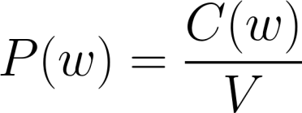



Building the model
4.
Calculate word probabilities
Word | Count
I | 2
am | 2
happy | 1
because | 1
learning | 1
Example: “I am happy because I am learning”
Probability of a word
Number of times the word appears
Total : 7
Total size of the corpus

Slide 54
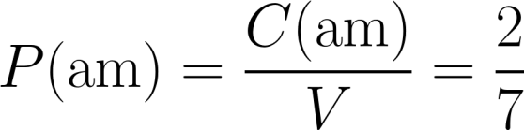
Building the model
4.
Calculate word probabilities
Word | Count
I | 2
am | 2
happy | 1
because | 1
learning | 1
Example: “I am happy because I am learning”
Probability of a word
Number of times the word appears
Total : 7
Total size of the corpus

Slide 55
Building the model
4.
Calculate word probabilities
deah yeah
dear
dean
… etc

Slide 56
Building the model
4.
Calculate word probabilities
deah → dear ✅
yeah
dear
dean
… etc

Slide 57
Summary
Identify a misspelled word
Find strings n edit distance away
Insert Delete Switch Replace
Filter candidates
Calculate word probabilities
deah → dear ☑️
yeah dear dean
… etc

Slide 58

Summary
Identify a misspelled word
Find strings n edit distance away
Insert Delete Switch Replace
Filter candidates
Calculate word probabilities
deah → dear ☑️
yeah dear dean
… etc

Slide 59
Summary
1. Identify a misspelled word
2. Find strings n edit distance away
Insert Delete Switch Replace
Filter candidates
Calculate word probabilities
deah → dear ☑️
yeah dear dean
… etc

Slide 60
Summary
1. Identify a misspelled word
2. Find strings n edit distance away
Insert Delete Switch Replace
deah → dear ☑️
_eah d_ar de_r
… etc
Filter candidates
Calculate word probabilities

Slide 61
Summary
Identify a misspelled word
Find strings n edit distance away
Insert Delete Switch Replace
deah → dear ☑️
yeah dear dean
… etc
1. Filter candidates
2. Calculate word probabilities

Slide 62
Summary
Identify a misspelled word
Find strings n edit distance away
Insert Delete Switch Replace
1. Filter candidates
deah → dear ☑️
yeah dear dean
… etc
2. Calculate word probabilities

Slide 63
Summary
Identify a misspelled word
Find strings n edit distance away
Insert Delete Switch Replace
1. Filter candidates
deah → dear ✅
yeah
dear
dean
… etc
2. Calculate word probabilities

Slide 64
Summary
Identify a misspelled word
Find strings n edit distance away
Insert Delete Switch Replace
Filter candidates
Calculate word probabilities
deah → dear ✅
yeah
dear
dean
… etc

Slide 65
Minimum edit distance
deeplearning.ai

Slide 66
Minimum edit distance
How to evaluate similarity between 2 strings?
Minimum number of edits needed to transform 1 string
into the other
Spelling correction, document similarity, machine
translation, DNA sequencing, and more

Slide 67
Minimum edit distance
Edits:
Insert (add a letter)
‘top’, ‘two’ …
‘to’:
Delete
‘at’, ‘ht’
Replace
…
(remove a letter)
‘hat’: ‘ha’,
(change 1 letter to another)
‘jaw’: ‘jar’, ‘paw’,

Slide 68
Minimum edit distance
Example:
Source:
p | l | a | y

Slide 69
Minimum edit distance
Example:
Source:
p | l | a | y
s Targe | t t: | a | y

Slide 70
Minimum edit distance
Example:
Source:
p | l | a | y
T^{s} g ar | _{e} t t: | a | y
What is the minimum number of edits to make this happen ?

Slide 71
Minimum edit distance
Example:
Source:
p | l | a | y
s Targe | t t: | a | y
p → s : replace

Slide 72
Minimum edit distance
Example:
Source:
p | l | a | y
s Tar | t get: | a | y
p → s : replace l → t : replace

Slide 73
Minimum edit distance
Example:
Source:
p | l | a | y
T^{s} g ar | _{e} t t: | a | y
p → s : replace l → t : replace

Slide 74
Minimum edit distance
Example:
Source:
p | l | a | y
s Targe | t t: | a | y
p → s : replace l → t : replace

Slide 75
Minimum edit distance
Example:
Source:
p | l | a | y
s Targe | t t: | a | y
p → s : replace l → t : replace
edits = 2

Slide 76
Minimum edit distance
Edit cost:
Insert 1
Delete 1
Example:
Source:
p | l | a | y
Replace 2
s Targe | t t: | a | y
p → s : replace l → t : replace
edits = 2

Slide 77
Minimum edit distance
Example:
Edit cost:
Insert 1
Delete 1
Source:
p | l | a | y
Replace 2
edit distance = 2 * 2 = 4
s Targe | t t: | a | y
p → s : replace l → t : replace
edits = 2

Slide 78
Minimum edit distance
Example:
c | o | n | v | o | l | u | t | i | o | n | a | l | n | e | u | r | a | l | n | e | t | w | o | r | k

Slide 79
Minimum edit distance
Example:
c | o | n | v | o | l | u | t | i | o | n | a | l | n | e | u | r | a | l | n | e | t | w | o | r | k
CCAAGGGGTGACTCTAGTTTAATATAACTGAGATCAAATTATATGGGTGAT🧬 !!

Slide 80
Minimum edit distance algorithm
deeplearning.ai

Slide 81
Minimum edit distance
Source: play → Target: stay
 |  | 0 | 1 | 2 | 3 | 4
 |  | # | s | t | a | y
0 | #
1 | p
2 | l
3 | a
4 | y

Slide 82
Minimum edit distance
Source: play
* Target: stay
 |  | 0 | 1 | 2 | 3 | 4
 |  | # | s | t | a | y
0 | #
1 | p
2 | l
3 | a
4 | y

Slide 83
Minimum edit distance
Source: play → Target: stay
 |  | 0 | 1 | 2 | 3 | 4
 |  | # | s | t | a | y
0 | #
1 | p
2 | l
3 | a
4 | y

Slide 84
Minimum edit distance
Source: play → Target: stay
 |  | 0 |  |  | 1 | 2 | 3 | 4
 |  | # |  |  | s | t | a | y
0 | #
1 | p
2 | l
3 | a
4 | y

Slide 85
Minimum edit distance
Source: play → Target: stay
 |  |  |  | 0 | 1 | 2 | 3 | 4
 |  |  |  | # | s | t | a | y
0 |  | #
1 |  | p
2 |  | l
3 |  | a
4 |  | y

Slide 86
Minimum edit distance
Source: play → Target: stay
D[ ]
 |  |  | 0 | 1 | 2 | 3 | 4
 |  |  | # | s | t | a | y
0 | #
1 | p
2 | l
3 | a
4 | y

Slide 87
Minimum edit distance
Source: play → Target: stay
D[ ]
D[2,3] = pl → sta
 |  | 0 | 1 | 2 | 3 |  | 4
 |  | # | s | t | a |  | y
0 | #
1 | p
2 | l
3 | a
4 | y

Slide 88
Minimum edit distance
Source: play → Target: stay
D[ ]
D[2,3] = pl → sta
D[2,3] = source[:2] → target[:3]
 |  | 0 | 1 | 2 | 3 |  | 4
 |  | # | s | t | a |  | y
0 | #
1 | p
2 | l
3 | a
4 | y

Slide 89
Minimum edit distance
Source: play → Target: stay
D[ ]
D[2,3] = pl → sta
D[2,3] = source[:2] → target[:3]
D[ i, j ] = source[ : i ] → target[ : j ]
 |  | 0 | 1 | 2 | 3 |  | 4
 |  | # | s | t | a |  | y
0 | #
1 | p
2 | l
3 | a
4 | y

Slide 90
Minimum edit distance
Source: play → Target: stay
D[ ]
D[ i, j ] = source[ : i ] → target[ : j ]
 |  |  | 0 | 1 | 2 | 3 | 4
 |  |  | # | s | t | a | y
0 | #
1 | p
2 | l
3 | a
4 | y

Slide 91
Minimum edit distance
Source: play → Target: stay
D[ ]
D[ i, j ] = source[ : i ] → target[ : j ]
D[ m, n ] = source → target
 |  | 0 | 1 | 2 | 3 |  | 4
 |  | # | s | t | a |  | y
0 | #
1 | p
2 | l
3 | a
4 | y

Slide 92
Minimum edit distance
Source: play → Target: stay
D[ ]
D[ i, j ] = source[ : i ] → target[ : j ]
D[ m, n ] = source → target
 |  | 0 | 1 | 2 | 3 | 4
 |  | # | s | t | a | y
0 | #
1 | p
2 | l
3 | a
4 | y

Slide 93
Minimum edit distance
Source: play → Target: stay
 |  | 0 | 1 | 2 | 3 | 4
 |  | # | s | t | a | y
0 | #
1 | p
2 | l
3 | a
4 | y
Cost: insert: 1, delete: 1, replace: 2

Slide 94
Minimum edit distance
Source: play → Target: stay
Cost: insert: 1, delete: 1, replace: 2
# → #
 |  | 0 |  | 1 | 2 | 3 | 4
 |  | #
0 | #
1
2
3
4

Slide 95
Minimum edit distance
Source: play → Target: stay
Cost: insert: 1, delete: 1, replace: 2
# → #
 |  | 0 |  | 1 | 2 | 3 | 4
 |  | #
0 | # | 0
1
2
3
4

Slide 96
Minimum edit distance
Source: play → Target: stay
Cost: insert: 1, delete: 1, replace: 2
p → #
 |  | 0 | 1 | 2 | 3 | 4
 |  | #
0 | # | 0
1 | p
2
3
4

Slide 97
Minimum edit distance
Source: play → Target: stay
Cost: insert: 1, delete: 1, replace: 2
p → #
delete
 |  | 0 | 1 | 2 | 3 | 4
 |  | #
0 | # | 0
1 | p | 1
2
3
4

Slide 98
Minimum edit distance
Source: play → Target: stay
Cost: insert: 1, delete: 1, replace: 2
# → s
 |  | 0 | 1 |  | 2 | 3 | 4
 |  | # | s
0 | # | 0
1 | p | 1
2
3
4

Slide 99
Minimum edit distance
Source: play → Target: stay
Cost: insert: 1, delete: 1, replace: 2
# → s
insert
 |  | 0 | 1 |  | 2 | 3 | 4
 |  | # | s
0 | # | 0 | 1
1 | p | 1
2
3
4

Slide 100
Minimum edit distance
Source: play → Target: stay
Cost: insert: 1, delete: 1, replace: 2
p → s
 |  | 0 | 1 | 2 | 3 | 4
 |  | # | s
0 | # | 0 | 1
1 | p | 1
2
3
4

Slide 101
Minimum edit distance
Source: play → Target: stay
Cost: insert: 1, delete: 1, replace: 2
p → s
insert + delete: p → ps → s
 |  | 0 | 1 | 2 | 3 | 4
 |  | # | s
0 | # | 0 | 1
1 | p | 1
2
3
4

Slide 102
Minimum edit distance
Source: play → Target: stay
Cost: insert: 1, delete: 1, replace: 2
p → s
 |  | 0 | 1 | 2 | 3 | 4
 |  | # | s
0 | # | 0 | 1
1 | p | 1
2
3
4
insert
+ delete: p → ps → s

Slide 103
Minimum edit distance
Source: play → Target: stay
Cost: insert: 1, delete: 1, replace: 2
p → s
 |  | 0 | 1 | 2 | 3 | 4
 |  | # | s
0 | # | 0 | 1
1 | p | 1
2
3
4
insert
+ delete: p → ps → s:
2

Slide 104
Minimum edit distance
Source: play → Target: stay
Cost: insert: 1, delete: 1, replace: 2
p → s
 |  | 0 | 1 | 2 | 3 | 4
 |  | # | s
0 | # | 0 | 1
1 | p | 1
2
3
4
insert
+ delete: p → ps → s:
2
delete + insert: p → # → s

Slide 105
Minimum edit distance
Source: play → Target: stay
Cost: insert: 1, delete: 1, replace: 2
p → s
 |  | 0 | 1 | 2 | 3 | 4
 |  | # | s
0 | # | 0 | 1
1 | p | 1
2
3
4
insert
+ delete: p → ps → s:
2
delete + insert: p → # → s

Slide 106
Minimum edit distance
Source: play → Target: stay
Cost: insert: 1, delete: 1, replace: 2
p → s
 |  | 0 | 1 | 2 | 3 | 4
 |  | # | s
0 | # | 0 | 1
1 | p | 1
2
3
4
insert
+ delete: p → ps → s:
2
delete + insert: p → # → s: 2

Slide 107
Minimum edit distance
Source: play → Target: stay
Cost: insert: 1, delete: 1, replace: 2
p → s
 |  | 0 | 1 | 2 | 3 | 4
 |  | # | s
0 | # | 0 | 1
1 | p | 1
2
3
4
insert
+ delete: p → ps → s:
2
delete + insert: p → # → s: 2
replace: p → s

Slide 108
Minimum edit distance
Source: play → Target: stay
Cost: insert: 1, delete: 1, replace: 2
p → s
 |  | 0 | 1 | 2 | 3 | 4
 |  | # | s
0 | # | 0 | 1
1 | p | 1
2
3
4
insert
+ delete: p → ps → s:
2
delete + insert: p → # → s: 2
replace: p → s

Slide 109
Minimum edit distance
Source: play → Target: stay
Cost: insert: 1, delete: 1, replace: 2
p → s
 |  | 0 | 1 | 2 | 3 | 4
 |  | # | s
0 | # | 0 | 1
1 | p | 1
2
3
4
insert
+ delete: p → ps → s:
2
delete + insert: p → # → s: 2
replace: p → s:
2

Slide 110
Minimum edit distance
Source: play → Target: stay
Cost: insert: 1, delete: 1, replace: 2
p → s
 |  | 0 | 1 | 2 | 3 | 4
 |  | # | s
0 | # | 0 | 1
1 | p | 1 | 2
2
3
4
insert
+ delete: p → ps → s:
2
delete + insert: p → # → s: 2
replace: p → s:
2

Slide 111
Minimum edit distance algorithm II
deeplearning.ai

Slide 112
Minimum edit distance
Source: play → Target: stay
Cost: insert: 1, delete: 1, replace: 2
 |  | 0 | 1 | 2 | 3 | 4
 |  | # | s | t | a | y
0 | # | 0 | 1
1 | p | 1 | 2
2 | l
3 | a
4 | y

Slide 113
Minimum edit distance
Source: play → Target: stay
Cost: insert: 1, delete: 1, replace: 2
play → #
 |  | 0 | 1 | 2 | 3 | 4
 |  | # | s | t | a | y
0 | # | 0 | 1
1 | p | 1 | 2
2 | l
3 | a
4 | y

Slide 114
Minimum edit distance
Source: play → Target: stay
Cost: insert: 1, delete: 1, replace: 2
0
1
2
3
4
 | # | s | t | a | y
# | 0 | 1
p | 1 | 2
l
a
y
play → #
0
1
D[ i, j ] = D[ i-1, j ] + del_cost
2
3
4

Slide 115
Minimum edit distance
Source: play → Target: stay
Cost: insert: 1, delete: 1, replace: 2
play → #
D[ i, j ] = D[ i-1, j ] + del_cost
 |  | 0 | 1 | 2 | 3 | 4
 |  | # | s | t | a | y
0 | # | 0 | 1
1 | p | 1 | 2
2 | l | 2
3 | a | 3
4 | y | 4

Slide 116
Minimum edit distance
Source: play → Target: stay
Cost: insert: 1, delete: 1, replace: 2
0
1
2
3
4
 | # | s |  | t | a | y
# | 0 | 1
p | 1 | 2
l | 2
a | 3
y | 4
play → #
0
1
D[ i, j ] = D[ i-1, j ] + del_cost
2
D[4,0] = play → #
= source[ :4] → target[0]
3
4

Slide 117
Minimum edit distance
Source: play → Target: stay
Cost: insert: 1, delete: 1, replace: 2
0
1
2
3
4
 | # | s | t | a | y
# | 0 | 1
p | 1 | 2
l | 2
a | 3
y | 4
# → play
0
1
2
3
4

Slide 118
Minimum edit distance
Source: play → Target: stay
Cost: insert: 1, delete: 1, replace: 2
# → play
D[ i, j ] = D[ i, j-1 ] + ins_cost
 |  | 0 |  | 1 | 2 | 3 | 4
 |  | # |  | s | t | a | y
0 | # | 0 |  | 1
1 | p | 1 |  | 2
2 | l | 2
3 | a | 3
4 | y | 4

Slide 119
Minimum edit distance
Source: play → Target: stay
Cost: insert: 1, delete: 1, replace: 2
# → play
D[ i, j ] = D[ i, j-1 ] + ins_cost
 |  | 0 | 1 | 2 | 3 | 4
 |  | # | s | t | a | y
0 | # | 0 | 1 | 2 | 3 | 4
1 | p | 1 | 2
2 | l | 2
3 | a | 3
4 | y | 4

Slide 120
Minimum edit distance
Source: play → Target: stay
Cost: insert: 1, delete: 1, replace: 2
p → s
D[i, j] =
 |  | 0 | 1 | 2 | 3 | 4
 |  | # | s | t | a | y
0 | # | 0 | 1 | 2 | 3 | 4
1 | p | 1 | 2
2 | l | 2
3 | a | 3
4 | y | 4
D[i - 1, j] + del_cost
D[i, j - 1] + ins_cost D[i - 1, j - 1] + rep_cost;
min
if src[i] ≠
tar[j]
0;
if src[i]
= tar[j]

Slide 121
Minimum edit distance
Source: play → Target: stay
Cost: insert: 1, delete: 1, replace: 2
p → s
D[i, j] =
 |  | 0 | 1 | 2 | 3 | 4
 |  | # | s | t | a | y
0 | # | 0 | 1 | 2 | 3 | 4
1 | p | 1 | 2
2 | l | 2
3 | a | 3
4 | y | 4
D[i - 1, j] + del_cost
min
D[i, j - 1] + ins_cost D[i - 1, j - 1] + rep_cost;
if src[i] ≠
tar[j]
0;
if src[i]
= tar[j]

Slide 122
Minimum edit distance
Source: play → Target: stay
Cost: insert: 1, delete: 1, replace: 2
p → s
D[i, j] =
D[i - 1, j] + del_cost
 |  | 0 | 1 | 2 | 3 | 4
 |  | # | s | t | a | y
0 | # | 0 | 1 | 2 | 3 | 4
1 | p | 1 | 2
2 | l | 2
3 | a | 3
4 | y | 4
min
D[i, j - 1] + ins_cost
D[i - 1, j - 1] + rep_cost; if src[i] ≠
tar[j]
0; if src[i]
= tar[j]

Slide 123
Minimum edit distance
Source: play → Target: stay
Cost: insert: 1, delete: 1, replace: 2
p → s
D[i, j] =
 |  | 0 | 1 | 2 | 3 | 4
 |  | # | s | t | a | y
0 | # | 0 | 1 | 2 | 3 | 4
1 | p | 1 | 2
2 | l | 2
3 | a | 3
4 | y | 4
D[i - 1, j] + del_cost
D[i, j - 1] + ins
D[i - 1, j - 1]
min
_cost
+ rep_cost; if src[i] ≠
tar[j]
0; if src[i]
= tar[j]

Slide 124
Minimum edit distance
Source: play → Target: stay
Cost: insert: 1, delete: 1, replace: 2
p → s
D[i, j] =
D[i - 1, j] + del_cost
 |  | 0 | 1 | 2 | 3 | 4
 |  | # | s | t | a | y
0 | # | 0 | 1 | 2 | 3 | 4
1 | p | 1 | 2
2 | l | 2
3 | a | 3
4 | y | 4
min
D[i, j - 1] + ins_cost
D[i - 1, j - 1] + rep_cost; if src[i] ≠
tar[j]
0; if src[i]
= tar[j]

Slide 125
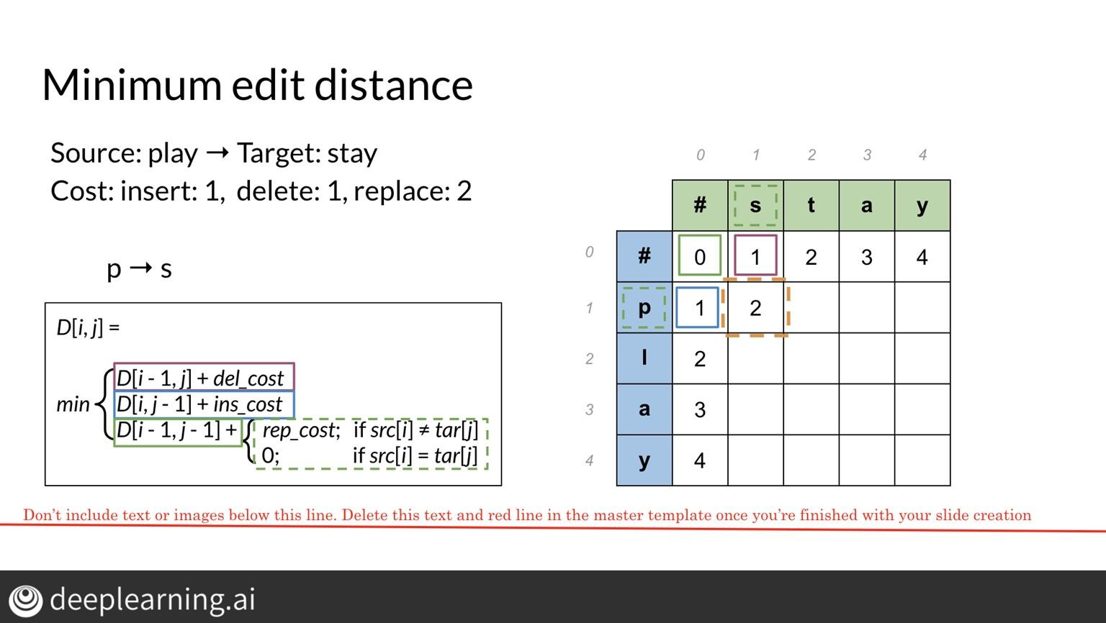
# dev purposes only
# image of how previous slide should be
# appearing for everyone !

Slide 126
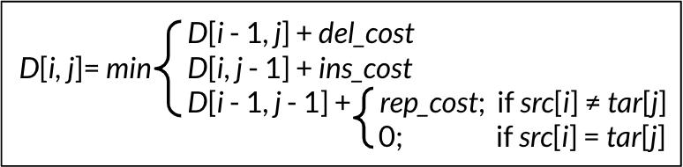
Minimum edit distance
Source: play → Target: stay
Cost: insert: 1, delete: 1, replace: 2
 |  | 0 | 1 | 2 | 3 | 4
 |  | # | s | t | a | y
0 | # | 0 | 1 | 2 | 3 | 4
1 | p | 1
2 | l | 2
3 | a | 3
4 | y | 4
FORMULAS BUILDING ONLY
EQUATION USED IN NEXT SLIDES
D[i - 1, j] + del_cost
D[i, j]= min
D[i, j - 1] + ins_cost
D[i - 1, j - 1] + rep_cost; if src[i] ≠ tar[j]
0; if src[i] = tar[j]

Slide 127
Minimum edit distance
Source: play → Target: stay
Cost: insert: 1, delete: 1, replace: 2
p → s
D[ i-1, j ] + 1 = 2
D[ i, j-1 ] + 1 = 2
D[ i-1, j-1 ] + 2 = 2
 |  | 0 | 1 | 2 | 3 | 4
 |  | # | s | t | a | y
0 | # | 0 | 1 | 2 | 3 | 4
1 | p | 1 | 2
2 | l | 2
3 | a | 3
4 | y | 4

Slide 128
Minimum edit distance
Source: play → Target: stay
Cost: insert: 1, delete: 1, replace: 2
p → s
 |  | 0 | 1 | 2 | 3 | 4
 |  | # | s | t | a | y
0 | # | 0 | 1 | 2 | 3 | 4
1 | p | 1 | 2
2 | l | 2
3 | a | 3
4 | y | 4
D[ i-1, j ] + 1 = 2
D[ i, j-1 ] + 1 = 2
D[ i-1, j-1 ] + 2 = 2

Slide 129
Minimum edit distance
Source: play → Target: stay
Cost: insert: 1, delete: 1, replace: 2
p → s
D[ i-1, j ] + 1 = 2
 |  | 0 | 1 | 2 | 3 | 4
 |  | # | s | t | a | y
0 | # | 0 | 1 | 2 | 3 | 4
1 | p | 1 | 2
2 | l | 2
3 | a | 3
4 | y | 4
D[ i, j-1 ] + 1 = 2
D[ i-1, j-1 ] + 2 = 2

Slide 130
Minimum edit distance
Source: play → Target: stay
Cost: insert: 1, delete: 1, replace: 2
p → s
D[ i-1, j ] + 1 = 2
D[ i, j-1 ] + 1 = 2
 |  | 0 | 1 | 2 | 3 | 4
 |  | # | s | t | a | y
0 | # | 0 | 1 | 2 | 3 | 4
1 | p | 1 | 2
2 | l | 2
3 | a | 3
4 | y | 4
D[ i-1, j-1 ] + 2 = 2

Slide 131
Minimum edit distance
Source: play → Target: stay
Cost: insert: 1, delete: 1, replace: 2
p → s
 |  | 0 | 1 | 2 | 3 | 4
 |  | # | s | t | a | y
0 | # | 0 | 1 | 2 | 3 | 4
1 | p | 1 | 2
2 | l | 2
3 | a | 3
4 | y | 4
D[ i-1, j ] + 1 = 2
D[ i, j-1 ] + 1 = 2
min
= 2
D[ i-1, j-1 ] + 2 = 2

Slide 132
Minimum edit distance
Source: play → Target: stay
Cost: insert: 1, delete: 1, replace: 2
0
1
2
3
4
 | # | s | t | a | y
# | 0 | 1 | 2 | 3 | 4
p | 1 | 2
l | 2
a | 3
y | 4
0
1
2
3
4

Slide 133
Minimum edit distance
Source: to → Target: go
Cost: insert: 1, delete: 1, replace: 2
 |  | 0 | 1 | 2
 |  | # | g | o
0 | # | 0 | 1 | 2
1 | t | 1 | 2 | 3
2 | o | 2 | 3
FOR QUIZ SETUP ONLY
… USED FOR IMAGES
ON QUIZ IN NEXT SLIDE

Slide 134
Minimum edit distance
Source: play → Target: stay
Cost: insert: 1, delete: 1, replace: 2
 |  | 0 | 1 | 2 | 3 | 4
 |  | # | s | t | a | y
0 | # | 0 | 1 | 2 | 3 | 4
1 | p | 1 | 2 | 3 | 4 | 5
2 | l | 2 | 3 | 4 | 5 | 6
3 | a | 3 | 4 | 5 | 4 | 5
4 | y | 4 | 5 | 6 | 5 | 4

Slide 135
Minimum edit distance
Source: play → Target: stay
Cost: insert: 1, delete: 1, replace: 2
0 |  | 1 | 2 | 3 | 4
 | # | s | t | a |  | y
# | 0 | 1 | 2 | 3 |  | 4
p l a y | 1 2 3 4 | 2 3 4 5 | 3 4 5 6 | 4 5 4 5 |  | 5 6 5 4
play → stay
0
1
D[ m, n ] = 4
2
3
4

Slide 136
Minimum edit distance
Source: play → Target: stay
Cost: insert: 1, delete: 1, replace: 2
0
1
2
3
4
# s
t
a
y
play → stay
0
#
0 1 2 3 4
1
p
1 2 3 4 5
D[ m, n ] = 4
l
2 3 4 5 6
2
3
a 3 4 5 4 5
4
y
4 5 6 5 4

Slide 137
Minimum edit distance
Source: play → Target: stay
Cost: insert: 1, delete: 1, replace: 2
play → stay
D[ m, n ] = 4
 |  | 0 | 1 | 2 | 3 | 4
 |  | # | s | t | a | y
0 | # | 0 | 1 | 2 | 3 | 4
1 | p | 1 | 2 | 3 | 4 | 5
2 | l | 2 | 3 | 4 | 5 | 6
3 | a | 3 | 4 | 5 | 4 | 5
4 | y | 4 | 5 | 6 | 5 | 4

Slide 138
Minimum edit distance
Source: play → Target: stay
Cost: insert: 1, delete: 1, replace: 2
 |  | 0 | 1 | 2 | 3 | 4
 |  | # | s | t | a | y
0 | # | 0 | 1 | 2 | 3 | 4
1 | p | 1 | 2 | 3 | 4 | 5
2 | l | 2 | 3 | 4 | 5 | 6
3 | a | 3 | 4 | 5 | 4 | 5
4 | y | 4 | 5 | 6 | 5 | 4

Slide 139
Minimum edit distance algorithm III
deeplearning.ai

Slide 140
Minimum edit distance
Source: play → Target: stay
Cost: insert: 1, delete: 1, replace: 2
Levenshtein distance
 |  | 0 | 1 | 2 | 3 | 4
 |  | # | s | t | a | y
0 | # | 0 | 1 | 2 | 3 | 4
1 | p | 1 | 2 | 3 | 4 | 5
2 | l | 2 | 3 | 4 | 5 | 6
3 | a | 3 | 4 | 5 | 4 | 5
4 | y | 4 | 5 | 6 | 5 | 4

Slide 141
Minimum edit distance
Source: play → Target: stay
Cost: insert: 1, delete: 1, replace: 2
Levenshtein distance
Backtrace
 |  | 0 | 1 | 2 | 3 | 4
 |  | # | s | t | a | y
0 | # | 0 | 1 | 2 | 3 | 4
1 | p | 1 | 2 | 3 | 4 | 5
2 | l | 2 | 3 | 4 | 5 | 6
3 | a | 3 | 4 | 5 | 4 | 5
4 | y | 4 | 5 | 6 | 5 | 4

Slide 142
Minimum edit distance
Source: play → Target: stay
Cost: insert: 1, delete: 1, replace: 2
Levenshtein distance
Backtrace
Dynamic programming
 |  | 0 | 1 | 2 | 3 | 4
 |  | # | s | t | a | y
0 | # | 0 | 1 | 2 | 3 | 4
1 | p | 1 | 2 | 3 | 4 | 5
2 | l | 2 | 3 | 4 | 5 | 6
3 | a | 3 | 4 | 5 | 4 | 5
4 | y | 4 | 5 | 6 | 5 | 4

Slide 143
Summary
deeplearning.ai

Slide 144
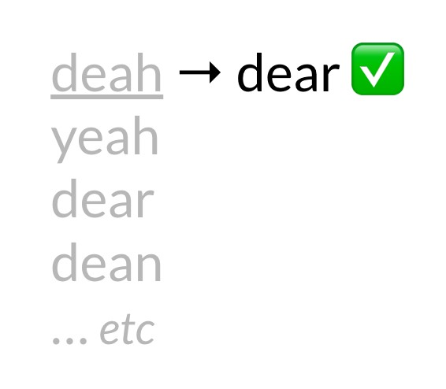
Summary - learning objectives
What is autocorrect ?
Building the model
Minimum edit distance
Minimum edit distance algorithm

